Slide 1
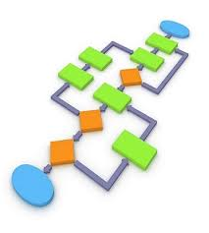
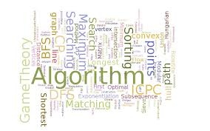
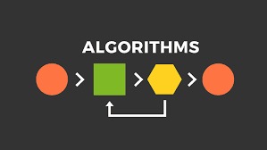
Algorithms
P1 Achieved
BY Aaron Mascarenhas

Slide 2
What is an Algorithms ?
An algorithm is used to solve problems that require instructions which perform specific tasks which need to be given rules and instructions for calculations, data processing or automated reasoning which is all done with the help of softwares as well as hardwares in a computer.

Slide 3
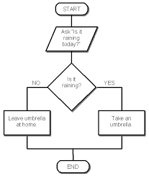
Flow Chart
A flowchart is a type of diagram that represents
an algorithm, workflow or process, showing
the steps as boxes of various kinds, and their
order by connecting them with arrows.
Flowcharts are used in analyzing, designing,
documenting or managing a process or
program in various fields.

Slide 4
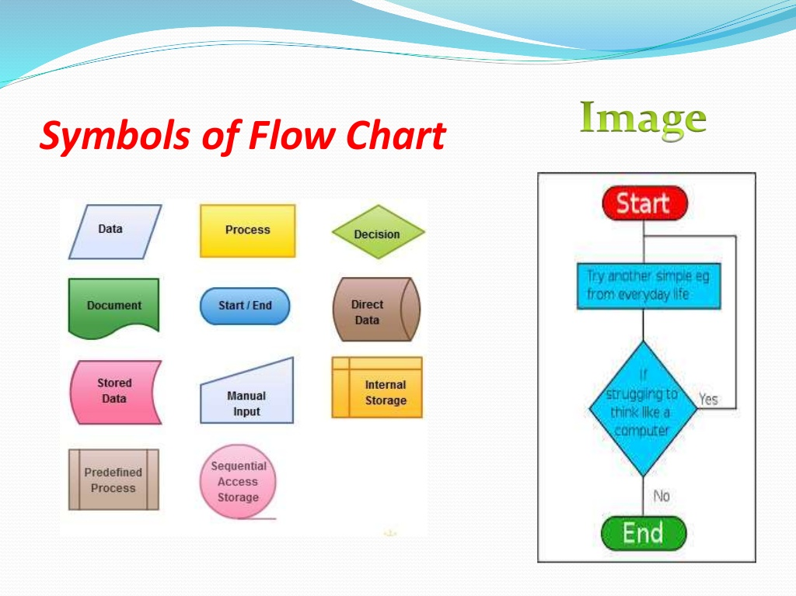
Symbols of a Flow Chart
Data
Process
Decision
Document
Start/End
Direct Data
Stored Data
Manual Input
Internal Storage
Predefined Process
Sequential Access Storage

Slide 5
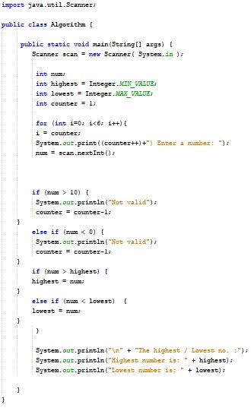
Pseudo code of a simple algorithm
1. Set number ‘num’
2. Set ‘highest’ and ‘lowest’
3. Set ‘counter’ equal to 1
4. for each loop from 0 to 6 add 1 till it equals to 6 which is shown as ‘i’
5. i = counter (so that it’s in sync with each other and end together when it’s both equal to 6)
6. Display counter which adds one ever loop and a message “counter+Enter a number” from the
User and store it in ‘num’
7. If the ‘num’ is more than 10 it is not valid, also if ‘num’ is less than 0 it is not valid & -1 from counter
8. If the ‘num’ is more than ‘highest’ value stored by the user, set ‘num’ to the ‘highest’ value
9. If the ‘num’ is less than the ‘lowest’ value stored by the user, set ‘num’ to the ‘lowest’ value
10. Display message saying “The Highest is : ‘highest’ value stored by the user’ ”
12. Display message saying “The Lowest is : ‘lowest’ value stored by the user’ ”

Slide 6
A Simple algorithm
Problem : An algorithm which returns the highest and lowest number on
the list of 5 which is between 0 to 10.
Input : An integer “num” which is between 0 and 10 must be entered 5 times.
Output : The highest and lowest number of the list.
Algorithm -
Set “num” to 0 , set “highest”, set “lowest”, set
”counter”
For each number “num” in the list “i”, compare it to “highest”, If “num” is larger,
set “highest” to “num”, and for each number “num” in the list “i”and compare it
to “lowest”, If “num” is smaller, set “lowest” to “num”.
“highest” is now set to the largest number in the list and “lowest” is set to
smallest number in the list.

Slide 7
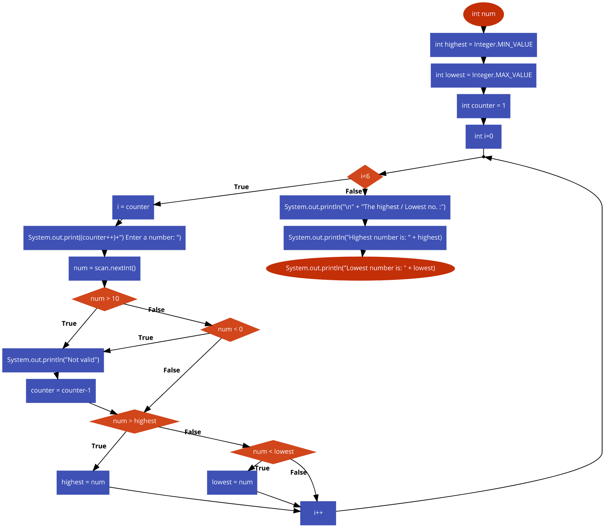
Flowchart for the Algorithm

Slide 8
Flowchart
Start
Highest = Integer.MIN_VALUE
Lowest = Integer.MAX_VALUE
Counter = 1
(counter++)+”) Enter a number:”
=
i=0, i<6 i++
Counter = counter - 1
num = scan.nextInt()
Yes
If num>10
Not valid
Yes
If num< 0
No
No
If num > highest
Yes
Highest = num
No
If num < lowest
Yes
Lowest = num
“The highest/lowest no. :”
“Highest number is :”+highest
“Lowest number is :”+lowest

Slide 9
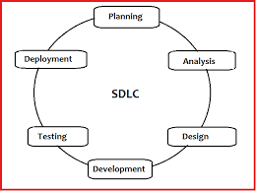
Software Development Life Cycle
SDLC Is a process that follows the software project.
It describes the development, maintenance, replacing and altering or enhancing specific software.
It the life cycle the shows how to improve the quality of the software.

Slide 10
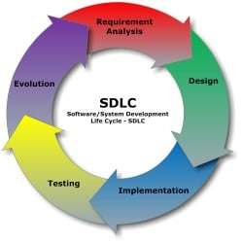
Software Development Life Cycle
The steps in a software development life cycle are -
Requirement Analysis
Design
Implementing
Testing
Evolution
M1 Achieved

Slide 11
Software Development Life Cycle
The steps in a software development life cycle are -
1) Requirement Analysis -
The stakeholder makes sure that the software requirements that has to be developed which achieves a specific goal. The aim of this stage is to get all of the details for the requirements and everyone is on track with the plan that needs to be achieved.

Slide 12
Software Development Life Cycle
2) Design -
In this stage of the SDLC, technical architects and developers come together to initiate a high-level design of the software which can deliver each requirements. Technical design are discussed with stakeholders, common causes such as risks, technologies used, capability of the team, project restrictions, time and budget are reviewed and accordingly a suitable design is developed for the product.

Slide 13
Software Development Life Cycle
3) Implementation -
When the requirements and design are met, developers start to implement the code according to the requirements and after the design is developed. Database admins start adding data requires in the database, and the GUI is created by the front-end developers and procedures and the guidelines are created by the back-end developers and are linked with each other, developers review each others code, run tests with their new codes which are written and implentment it in the software.

Slide 14
Software Development Life Cycle
4) Testing -
After the implementation is done, testing is the final stage in the SDLC before it is released to the final user. Qualified tester run tests on the system which meet the requirements. When a defect is found by the tester it is immediately informed if it is valid, to the developers and they release an update for the software which will go through testing once again the make sure the requirements are met.

Slide 15
Software Development Life Cycle
5) Evolution -
It is basically software updates after it is deployed to user and is tested to make sure the main issues are fixed and released. The maintenance team usually take care of any issues that may occur during its life cycle and handle any post-production issues. Depending on the issue if it very crucial and it can be fixed in a short period of time or if not too crucial that it can wait for the next update of teh software.

Slide 16


Importance of algorithm design
It is used to store and access large quantities of data efficiently.
It is used to solve complex computational problems and to design of good programs.
It is important to justify an algorithm correctness mathematically.
It provides clear, simple and unambiguous description.

Slide 17

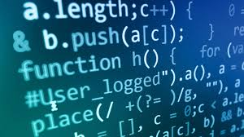
Conclusion
An algorithm is one of the most enforceable solution program that can be used to solve any complicated, complex, and hard program.
Under considering the above case the concerned authority included the jubilant students should prefer this program with great care.
Softwares follow a SDLC which goes through the steps which designs, tests requirements, and maintenance of the software to make it run effectively as required by the user.

